Slide 1
More detailed information on this topic including case studies can be found on the Capstone 1 website at the “Informed Consent” link.
Informed Consent
Let’s get started…
Some information adapted from web-based education course in the "Protection of Human Research Participants Training Course“, The Rutgers Medical School

Slide 2
The nature of biomedical engineering is that it will involve the implementation of devices and therapies in humans. It is unavoidable that humans be involved in the research and development of these devices and therapies.
What guiding principles should govern the conduct of the research on humans to acquire that understanding..?
The critical role of human participants in medical research is to serve as sources of data needed to assess the value of the research and implement therapies.
Understanding the function and repair of he human body is an ancient endeavor…

Slide 3
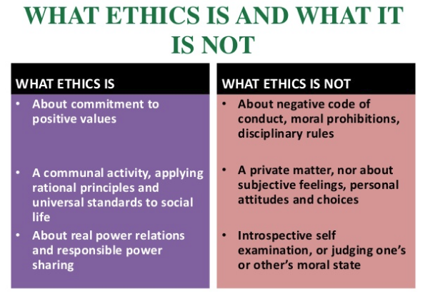
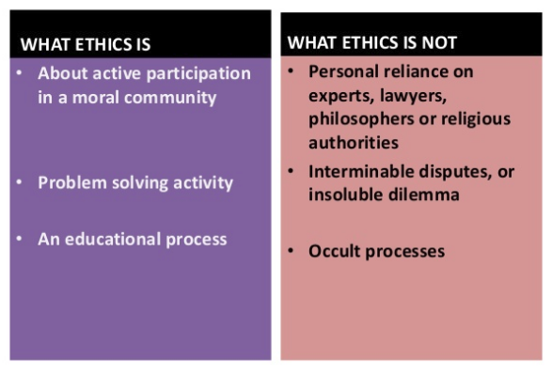
Ethics vs. morals
Morals are the principles on which one’s judgments of right and wrong are based. Ethics are principles of right conduct. So the two nouns are closely related and are often interchangeable. The main difference is that morals are more abstract, subjective, and often personal or religion-based, while ethics are more practical, conceived as shared principles promoting fairness in social and business interactions.
http://grammarist.com/usage/ethics-morals/

Slide 4
Medical research will require human experimentation. Ancient Greek doctors experimented on prisoners, but rarely did any surgical procedures.
The Roman physician Galen of Pergamom treated injured and dying gladiators, and as a consequence, had a more practical acquaintance with the inner workings of the body. It is reported that he was not averse to using the surgical knife, and he was known to perform public vivisections on animals.
http://broughttolife.sciencemuseum.org.uk/broughttolife/techniques/humansubjectresearch
https://www.thelancet.com/journals/lancet/article/PIIS0140-6736(13)62314-4/fulltext

Slide 5
Greek Medicine
The Greeks did not have a well developed concept of the human body as a physical entity, because the distinction between the spiritual and physical worlds are often blurred in Greek medicine. Famous medical practitioners included the 4th century BCE figures of Diocles of Carystus (noted for removing arrowheads), Praxagoras of Cos (noted for his ‘discovery’ of the pulse and being the first to distinguish veins from arteries). Medical treatments often utilised natural plants such as herbs and roots but could also include the use of amulets and charms. Surgery was generally avoided as it was considered too risky. The lack of practical knowledge resulted in some fundamental errors such as Aristotle’s belief that the heart and not the brain controlled the body and the idea proposed in the treatise On Ancient Medicine (5th century BCE) that physical pain arises from the body’s inability to assimilate certain foods.
https://www.ancient.eu/Greek_Medicine/

Slide 6
Hippocrates Introduces Ethics to Medicine
It is difficult to isolate the facts of Hippocrates’ life from the later tales told about him or to assess his medicine accurately in the face of centuries of reverence for him as the ideal physician. About 60 medical writings have survived that bear his name, most of which were not written by him. He has been revered for his ethical standards in medical practice, mainly for the Hippocratic Oath, which, it is suspected, he did not write.
The famous Hippocratic Oath (5th Century BCE) was actually a religious document ensuring a doctor operated within and for community values. With the Oath the practitioner swore by Apollo, Hygieia and Panacea to respect their teacher and not to administer poison, not to abuse patients in any way, use a knife or break the confidentiality between patient and doctor.
https://www.ancient.eu/Greek_Medicine/
https://www.britannica.com/biography/Hippocrates

Slide 7
Roman Medicine
The Romans were more practical in their approach to medicine. Galen of Pergamum (131 - 201 AD), gained prominence as a physician by treating wounded and dying gladiators. He demonstrated the error of Aristotle's notion that the heart was the seat of reason, by observing that a gladiator wounded in the heart remained lucid until death. It is recorded that he had an exceptional audacity in public vivisections of animals.
He worked diligently to expand medical knowledge. Moving away from the mystical approach, he dissected, studying the workings of human anatomy, and experimented with many procedures in order to find real workable solutions to medical issues. Because of Galen, the Roman knowledge of anatomy was quite impressive, and many of his surgical techniques were only surpassed in the modern age. Equally important as his actual work, he diligently recorded his exhaustive studies in a series of books.
https://www.unrv.com/medicine.php
https://www.ncbi.nlm.nih.gov/pmc/articles/PMC4495509/

Slide 8
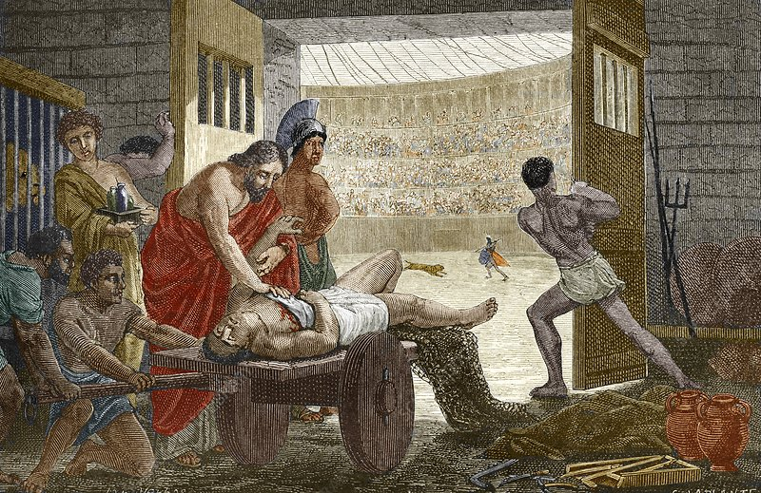
Galen treating a gladiator in Pergamum
Vies des savants illustres de la Renaissance : avec l'appréciation sommaire de leurs travaux by Figuier, Louis, 1819-1894
https://www.sciencephoto.com/media/225605/view/galen-treating-a-gladiator-in-pergamum

Slide 9
Surgeons of the 10th and 19th centuries did not conduct clinical trials as we understand them today. They experimented on their patients.
Edward Jenner (1749 – 1823) injected an 8 year old boy with cowpox and months later injected the boy with smallpox. The boy survived.
https://www.ncbi.nlm.nih.gov/pmc/articles/PMC1200696/
Aside from the Greek Hippocratic Oath, there was no uniformly applied convention of medical ethics until the end of WWII
In the United Kingdom, the Anatomy Act of 1832 gave legal sanction to physicians, surgeons, and students to obtain corpses that were unclaimed after death – in particular, corpses of those who had died in hospital, prison, or a workhouse.
https://en.wikipedia.org/wiki/Anatomy_Act_1832
American surgeon, James Marion Sims (1813 – 1883), developed surgery to correct vesico-vaginal fistulae by experimenting on female slaves who developed this complications in childbirth.
https://www.history.com/news/the-father-of-modern-gynecology-performed-shocking-experiments-on-slaves

Slide 10
20th Century, modern ethical principles of conducting human research emerged out of the atrocities of WWII. They were formulated as the Nuremberg code (1949) during the trial of Nazi war criminals. There were three basic elements of the Nuremberg Code,
Voluntary informed consent
Favorable risk/benefit analysis
Right to withdraw without repercussions
These became the foundation for subsequent ethical codes and research regulations.
https://www.ncbi.nlm.nih.gov/pubmed/18811995

Slide 12
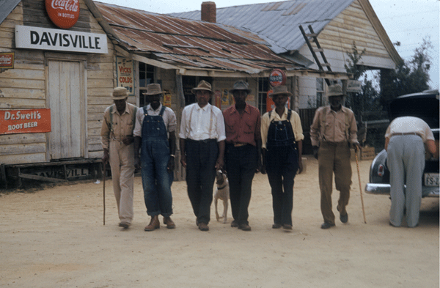
The Tuskegee Syphilis Study
On May 16, 1997, President Clinton apologized to the survivors and families of hundreds of men used in a research project to study the progression of untreated syphilis. These men were mainly sharecroppers from Macon County, Alabama (the area surrounding Tuskegee). They were poor, African American, and had few resources available to them. In 1932, when they were offered free medical care by physicians and researchers involved with the United States Public Health Service, they were led to believe there was a treatment for what they had been told was "bad blood." Instead, they were enrolled in an observational research study, without their knowledge or consent. In exchange for their participation (which included agreeing to an autopsy at death), the men received free medical examinations (primarily to provide data for the study), transportation and hot meals on the days of their examinations, and $50 for burial expenses. Even though some rudimentary remedies for syphilis were available in the early years of the study, they were not offered to these men, so that the study of the natural progression of the untreated disease would not be jeopardized. The study did not end until 1972.
https://www.nlm.nih.gov/archive/20040829/pubs/cbm/hum_exp.html#1
https://en.wikipedia.org/wiki/Tuskegee_syphilis_experiment

Slide 13
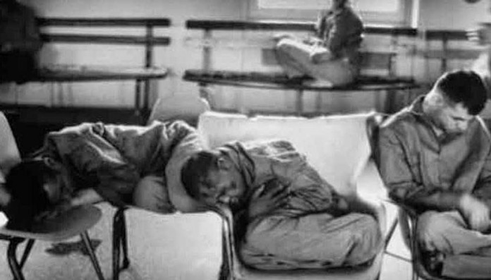
https://firsttoknow.com/5-creepy-experiments-done-on-children/

Slide 14
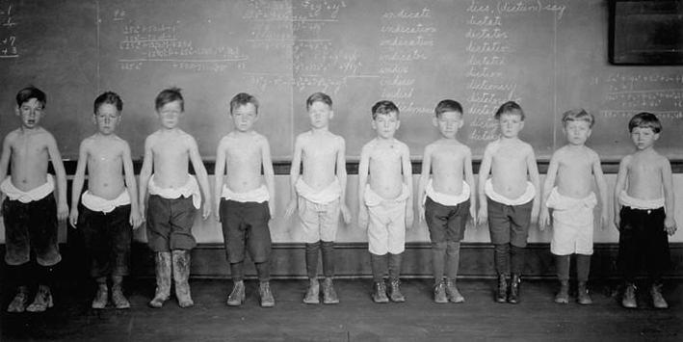
https://ahrp.org/the-dark-secret-of-the-mit-science-club/

Slide 15
https://www.slideshare.net/panthanalil/ethics-in-research-ppt-by-jiya

Slide 16
Not Just Urban Legend
Organ trafficking was long considered a myth. But now mounting evidence suggests it is a real and growing problem, even in America.
by Jeneen InterlandiJanuary 10, 2009
By the time her work brought her back to the United States, Nancy Scheper-Hughes had spent more than a decade tracking the illegal sale of human organs across the globe. Posing as a medical doctor in some places and a would-be kidney buyer in others, she had linked gangsters, clergymen and surgeons in a trail that led from South Africa, Brazil and other developing nations all the way back to some of her own country's best medical facilities. So it was that on an icy February afternoon in 2003, the anthropologist from the University of California, Berkeley, found herself sitting across from a group of transplant surgeons in a small conference room at a big Philadelphia hospital…
Successful of medical therapies and surgical interventions cannot be implemented without the consideration of ethical issues. In some cases, success exacerbates the issues..!

Slide 17
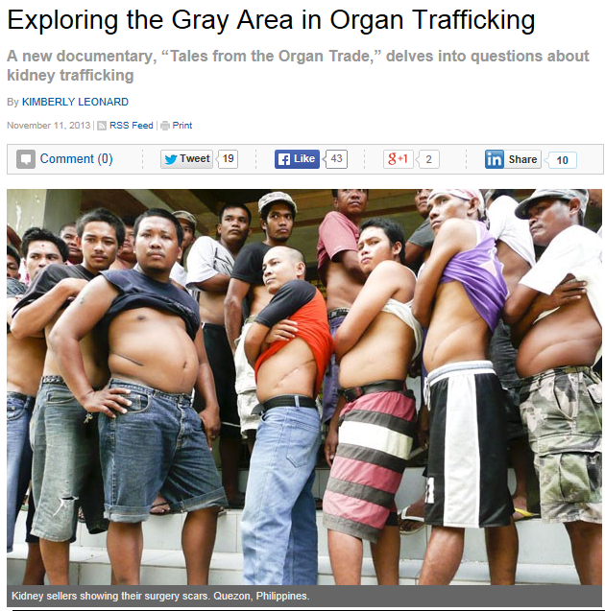
The technical success of organ transplant procedures has created ethical problems in the process of obtaining organs for transplantation.
In particular is the question of “personhood”. Should any class or group of people be taken advantage of because they are identified as “less valuable” or “less human” and thus coercively viewed a source for organs.
How can the ethical distinction between voluntary donation and monetary incentives for organs be articulated and then constructively resolved..?
https://www.sciencedirect.com/science/article/pii/S0955470X08000347?via%3Dihub
“Philosophy of organ donation: Review of ethical facets”, https://www.ncbi.nlm.nih.gov/pmc/articles/PMC4478599/

Slide 18
Real vulnerabilities depend on cultural factors. Is there a group or groups in the sub-cultural population that are considered disposable or less than human..?
https://www.slideshare.net/panthanalil/ethics-in-research-ppt-by-jiya

Slide 19
Numerous research improprieties between 1950 and 1974 in the United States prompted Congressional deliberations about human-subject-research oversight. Congress's first legislation to protect the rights and welfare of human subjects was the National Research Act of 1974, which created the National Commission for Protection of Human Subjects of Biomedical and Behavioral Research, which issued the Belmont Report.

Slide 20
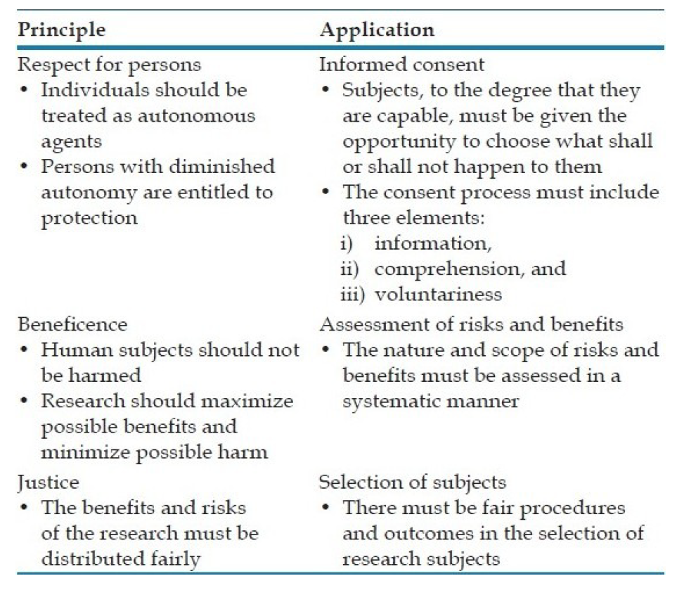
Three Ethical Principals as Outlined in Belmont Report

Slide 21
Federal agencies have adopted the DHHS regulations, as subsequently amended, as a Common Rule to protect human participants in any research protocol that those agencies sponsor.
The main elements of the Common Rule include:
requirements for assuring compliance by research institutions
requirements for researchers obtaining and documenting informed consent
requirements for Institutional Review Board (IRB) membership, function, operations, review of research, and record keeping
additional protection for certain vulnerable research subjects – pregnant women, prisoners, and children

Slide 23
Informed Consent
Information: human research subjects must be given sufficient information.
Comprehension: it is the responsibility of the research to make sure that the subject is able to comprehend the information.
Voluntariness: an agreement to participate in research constitutes a valid consent only if voluntarily given.

Slide 24
Assessment of Risks and Benefits
Nature and scope of risks and benefits: The assessment of risk and benefit must not only include the individual subjects, but also the families of the individual subjects and the society at large.
Systematic assessment of risks and benefits: the researcher’s estimates of probability of harm or benefits must be reasonable as judged known facts and/or other available studies.

Slide 25
Justice in the Selection of Subjects
Individual justice in the selection of subjects would require that researchers exhibit fairness: thus, they should not offer potentially beneficial research only to some patients, who are in their favor, or select only "undesirable" persons for risky research.
Social justice requires that distinction be drawn between classes of subjects that ought, and ought not, to participate in any particular kind of research.

Slide 26
Does that solve the problem..?

Slide 27
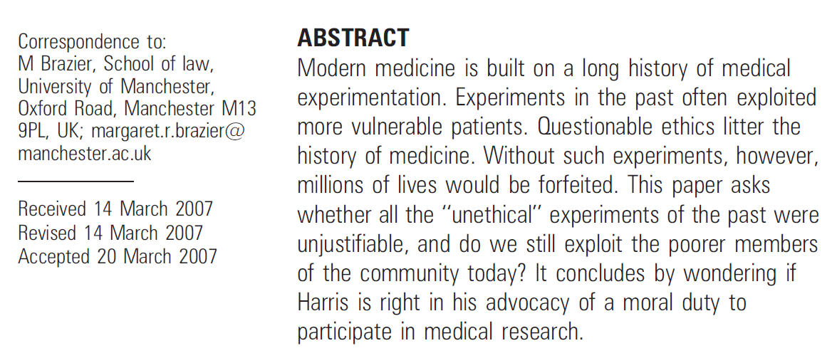
https://jme.bmj.com/content/medethics/34/3/180.full.pdf

Slide 28
The risk of harm in human medical research and the application of medical technology can never be underestimated. All medical research and medical technology is well intended, but that is not always the ultimate outcome. Anticipating benefits and assessing problems must be done with integrity. Addressing this issue requires constant vigilance..!

Slide 29
Sometimes it’s not so straightforward…
The placebo paradox
Cultural role of doctors
The “greater good” dilemma

Slide 30
Senate Votes to Stop EPA from Allowing Testing of Toxic Pesticides on Humans
Senator Conrad Burns, a Montana Republican, reminded fellow senators of a 2004 report by the National Academies on intentional human dosing with pesticides which found "that in certain cases the societal benefits of such studies outweigh the risks."
WASHINGTON, DC, January 25, 2006 (ENS) - Three U.S. legislators were asking the U.S. Environmental Protection Agency (EPA) to withdraw a planned rule to permit pesticide experimentation on humans, including pregnant and nursing mothers and children.
EPA Human Testing Policy

Slide 31
The constant vigilance operationally takes the form of local committees to review the impact of any research that involves humans…

Slide 32
The Office of Human Research Protections oversees Title 45, Part 46 of the Code for Federal Regulations, which pertains to human-subjects research. That office indirectly oversees human-subjects research through local institutional review boards (IRB). Since their inception, the principles of conducting human research, IRBs, and the Code for Federal Regulations have all advanced substantially.

Slide 33
The Institutional Review Board (IRB)
An IRB is an appropriately constituted group that has been formally designated to review and monitor biomedical research involving human subjects. In accordance with FDA regulations, an IRB has the authority to approve, require modifications in (to secure approval), or disapprove research. This group review serves an important role in the protection of the rights and welfare of human research subjects.
IRBs use a group process to review research protocols and related materials (e.g., informed consent documents and investigator brochures) to ensure protection of the rights and welfare of human subjects of research.
https://www.fda.gov/RegulatoryInformation/Guidances/ucm126420.htm

Slide 34
In compliance with federal regulations, NJIT has an Institutional Review Board to regulate all research involving humans and animals. Under a Federal wide Assurance with the United States Department of Health and Human Services, all research involving human subjects performed by NJIT faculty, staff, and students either on-campus or off-campus, including at other institutions, must be reviewed and approved prior to initiation by the NJIT Institutional Review Board (IRB).
NJIT IRB Purpose:
http://www.njit.edu/research/compliance/review-board/
NJIT IRB Forms and Protocols:
http://www.njit.edu/research/compliance/review-board/forms.php
Frequently Asked Question about NJIT IRB:
http://www.njit.edu/research/sites/research/files/lcms/pdf/Frequently-Asked-Questions-v1.pdf

Slide 35
Institutional Animal Care and Use Committee (IACUC)
To prevent the Galen-like animal mutilation, NJIT works through Rutgers University-Newark for the registration, review and approval of any research using vertebrate animals. (That includes the frogs for your boat experiments in Dr. Mantilla’s class.)
The IACUC review and approval is required to ensure compliance with all regulations, policies and standards that protect animal welfare as specified in the amended Animal Welfare Act (AWA) regulations contained in 9 CFR Part 2, Subpart 2C, Section 2.37
https://www.njit.edu/research/compliance/

Slide 36
Assignments
Team: Locate the NJIT IRB form and fill it out for your project (link below)
Individual: Complete the Citiprogram assignment shown on the following slides:
https://research.njit.edu/sites/research/files/lcms/pdf/Human-Subjects-Research-Initial-Review-Form_01-2015.pdf

Slide 37
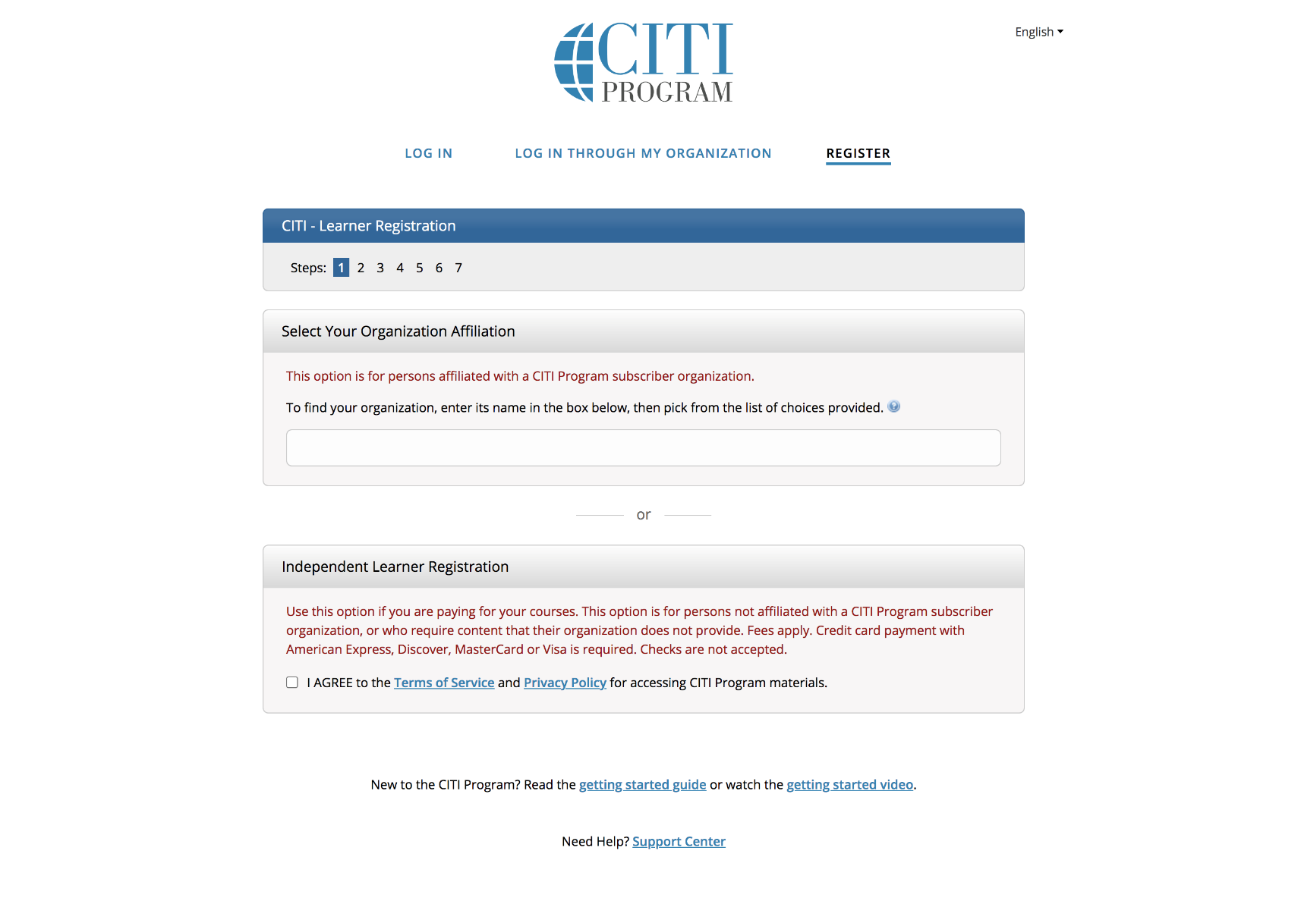
Go to https://about.citiprogram.org/en/homepage/ Click on register and follow the 7 steps to register.

Slide 38
When done, Log on to the WebSite

Slide 39
Click on View Courses

Slide 40
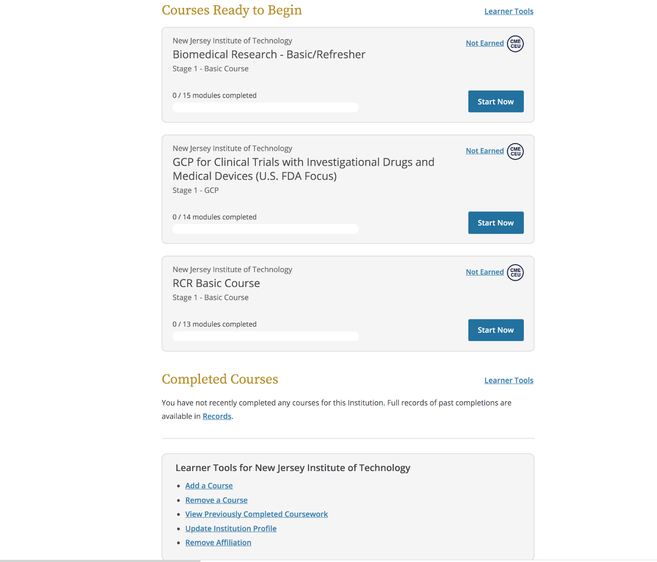
Click on Add a Course and choose the first course in this list

Slide 41
Start the course
Complete and take the quiz for the first 4 modules of this course:
Belmont Report and its Principles
History and Ethics of Human Subjects Research
Basic Institutional Review Board
Informed consent

Slide 42
Report the results
Perform a screen (PDF) print of the page that shows you have completed the 4 modules with your quiz grades
Email by the due date the PDF file to us with your name and the time it took you to complete the modules.

Slide 43
Questions..?

